Slide 1
.balance
. Julian Mautner . Stefan Andersson . Sebastian Kreisel

Slide 2

.balance :: mechanics

Slide 3
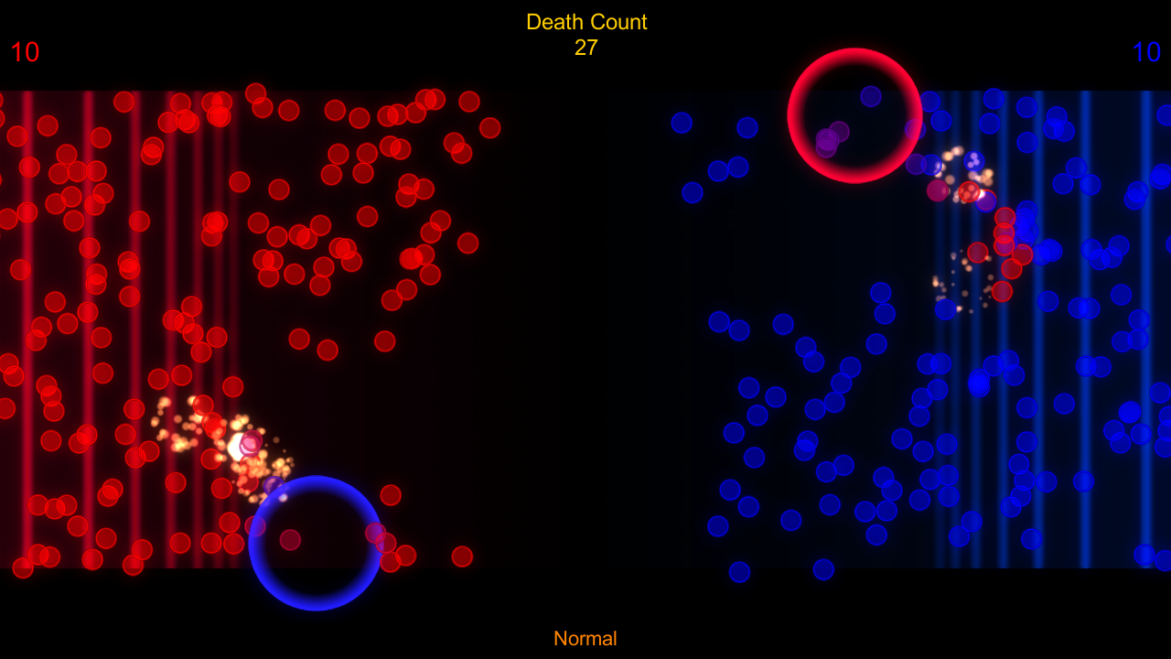
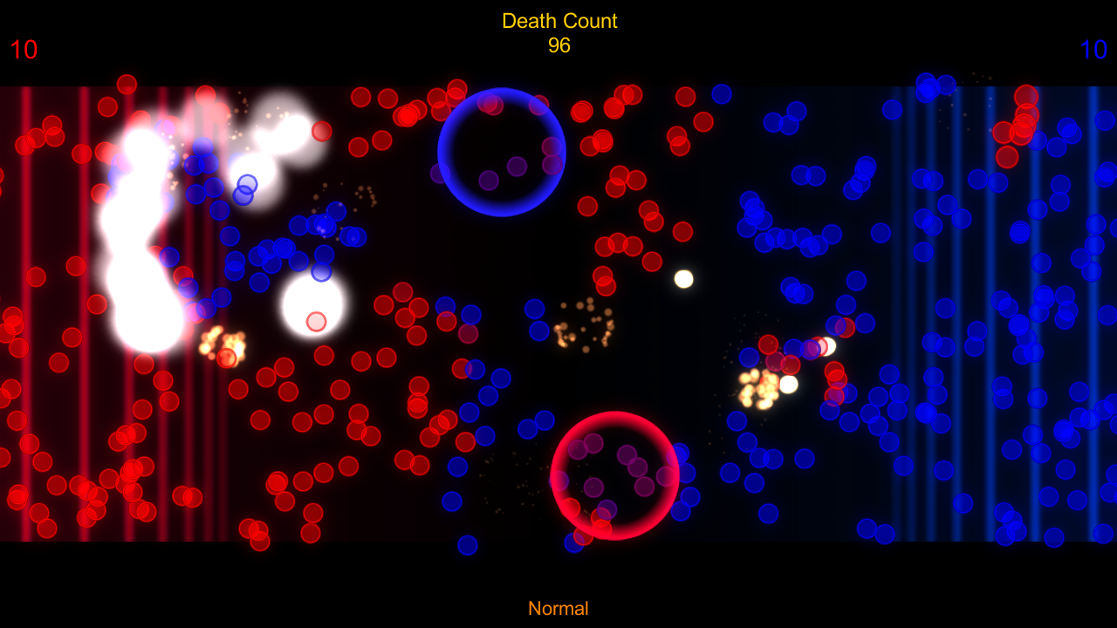
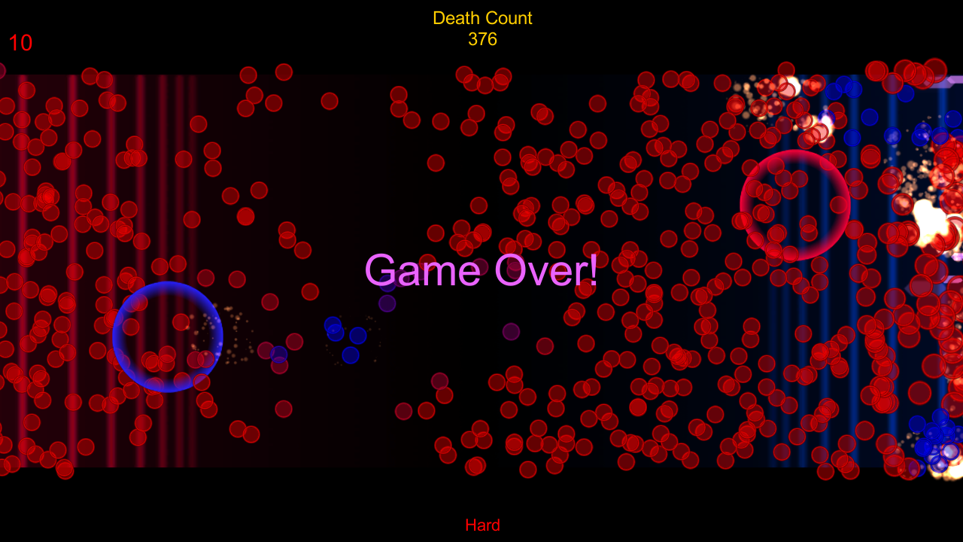
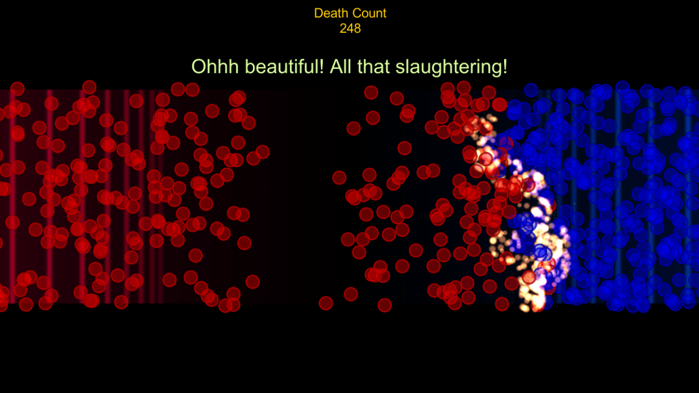
.balance :: features
.unique control scheme
.awesome tutorial
.three difficulty levels
.CHAOS

Slide 4
.balance :: trailer

Slide 5
.thanks
. Julian Mautner . Stefan Andersson . Sebastian Kreisel
.tools & .resources
Unity3D, Audacity, VS, Magix, Fraps,
royality free sounds & music

